Slide 1
The Energy Transition and Seabed Mining
Scot W. Anderson
Paul M. Hebert Law Center
Louisiana State University
January 31, 2025

Slide 2
The Energy Transition Requires a Lot of Metal
Notes:
STEPS – Stated Policy Scenario
SDS – Sustainable Development Scenario

Slide 3
Terrestrial Mining Projects Face Opposition and Take Time to Develop

Slide 4
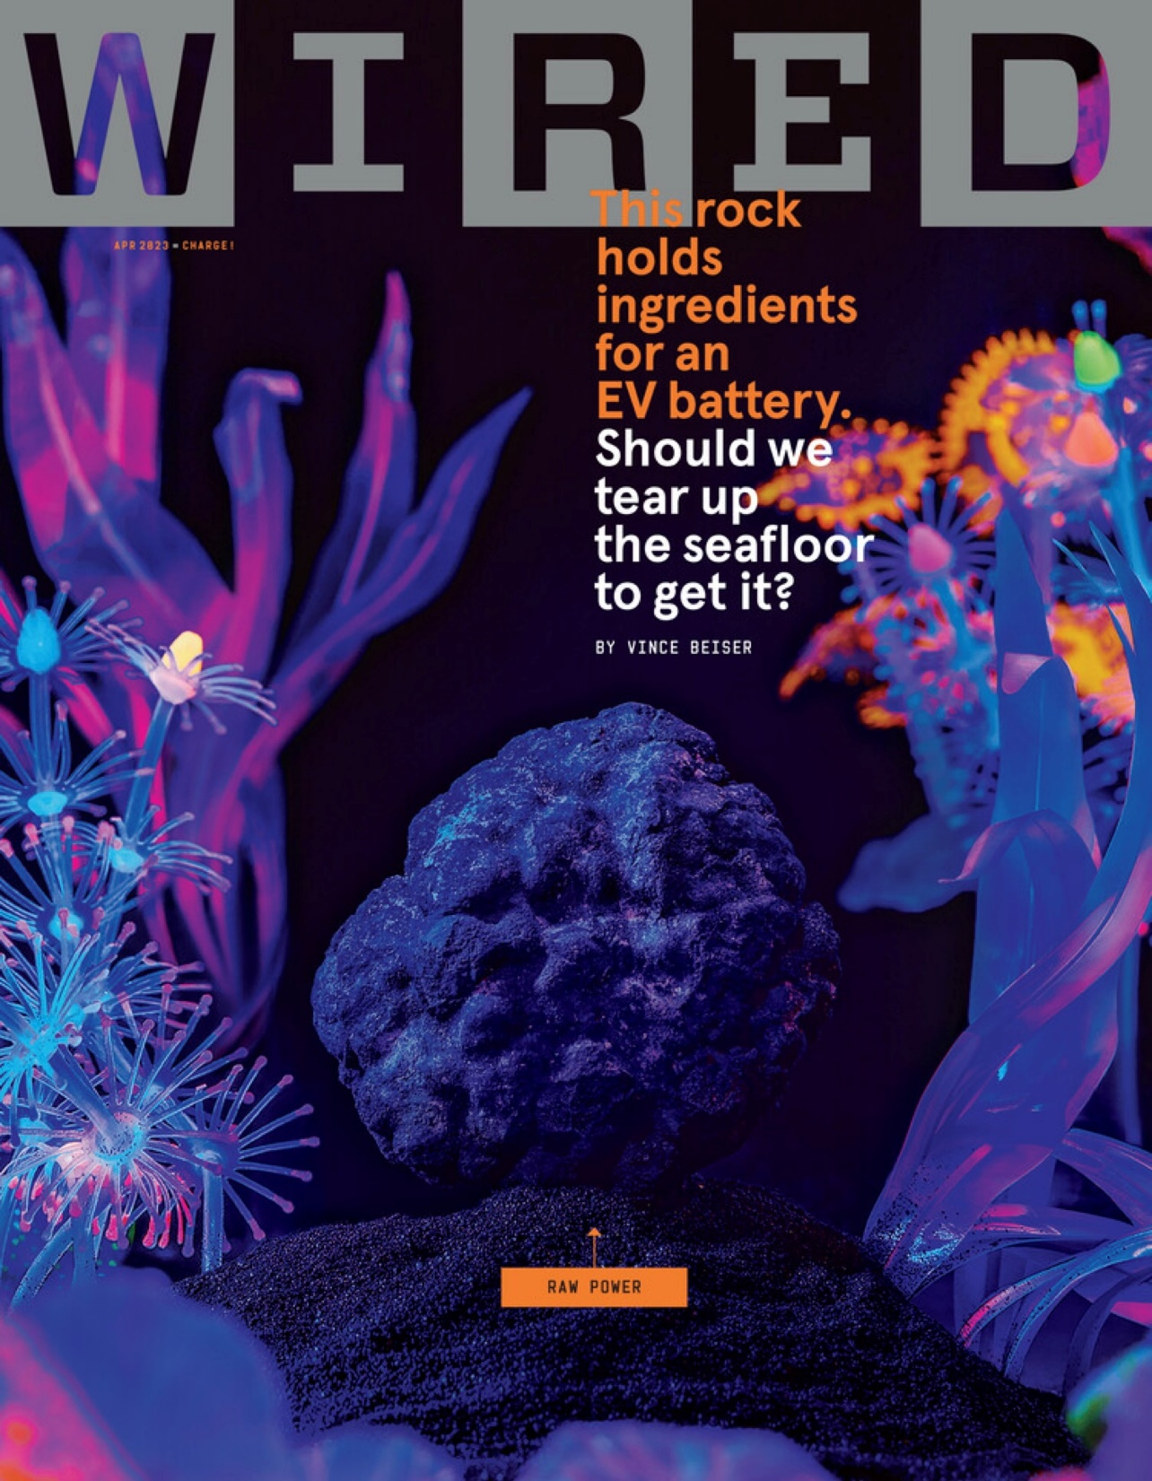

Slide 5
A Statement of the Dilemma
Will we fall short of achieving the Paris Agreement climate goals due to a lack of metals,
or will we turn to the deep sea and accept the environmental impacts of deep seabed mining.

Slide 7
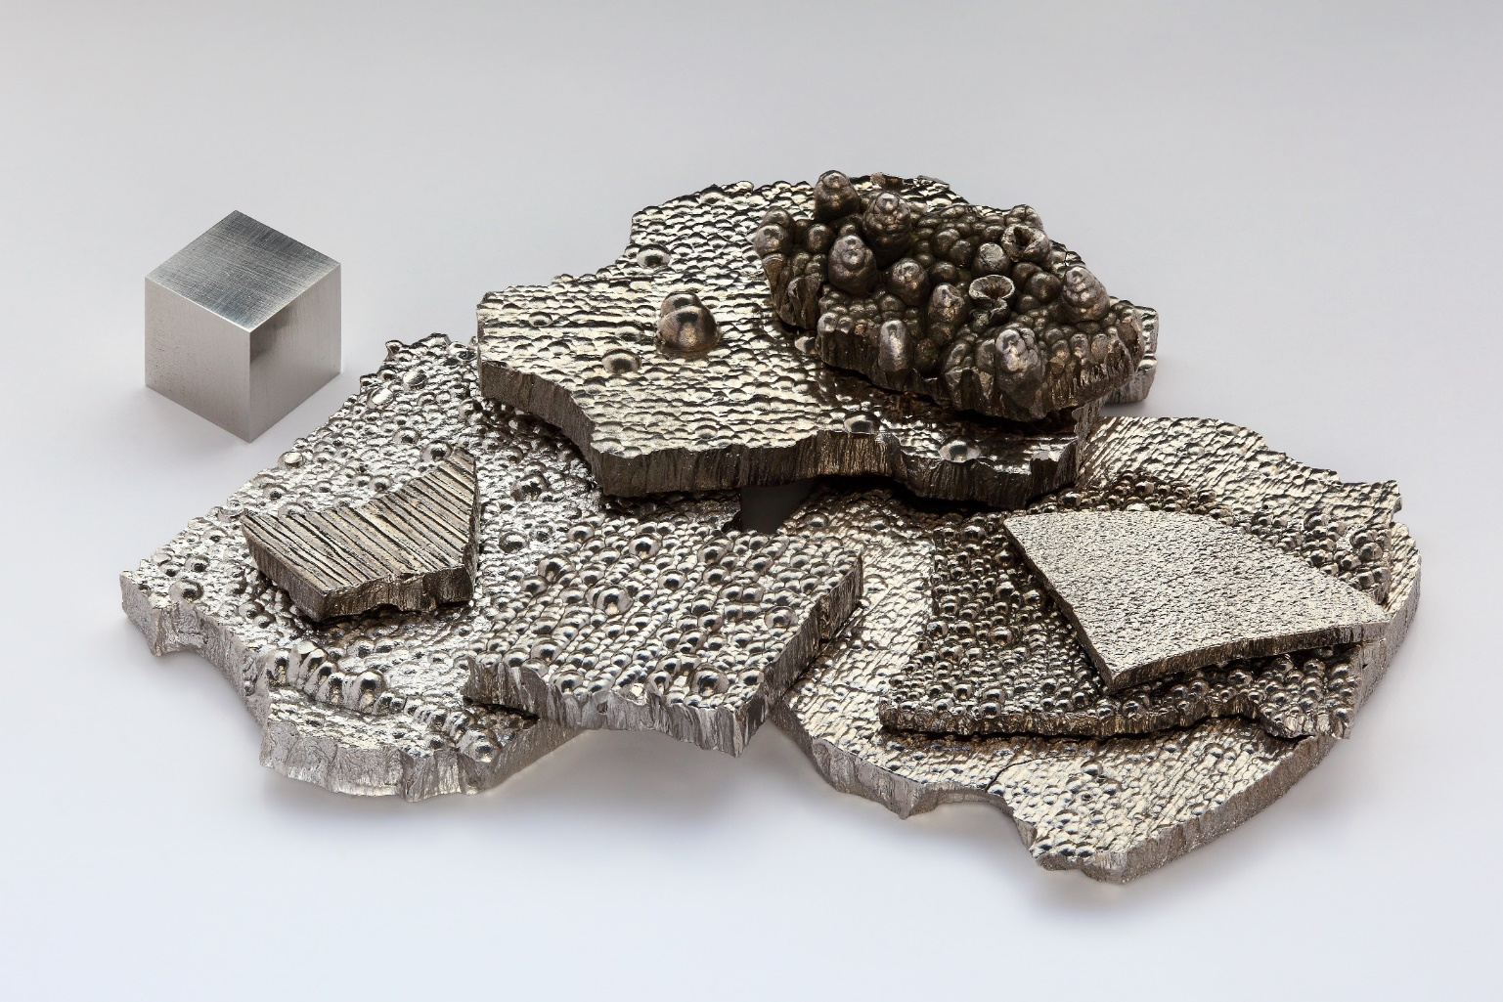
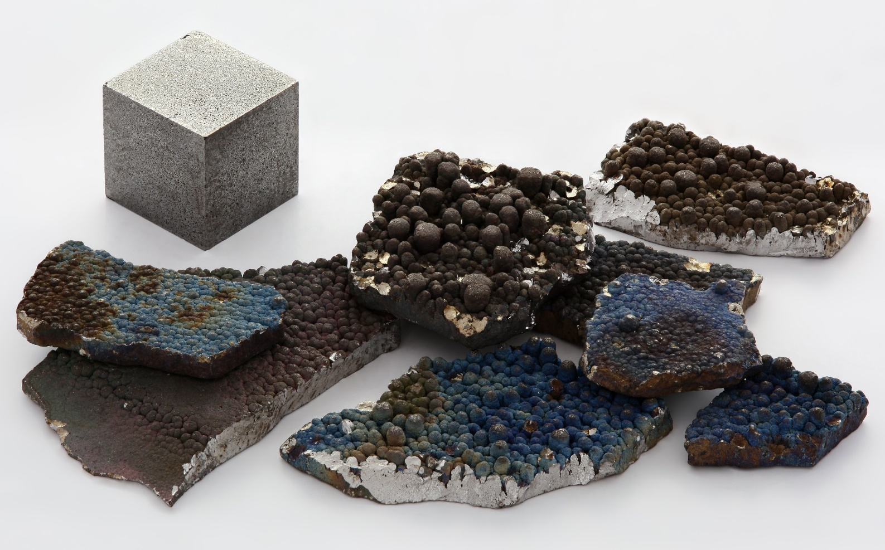
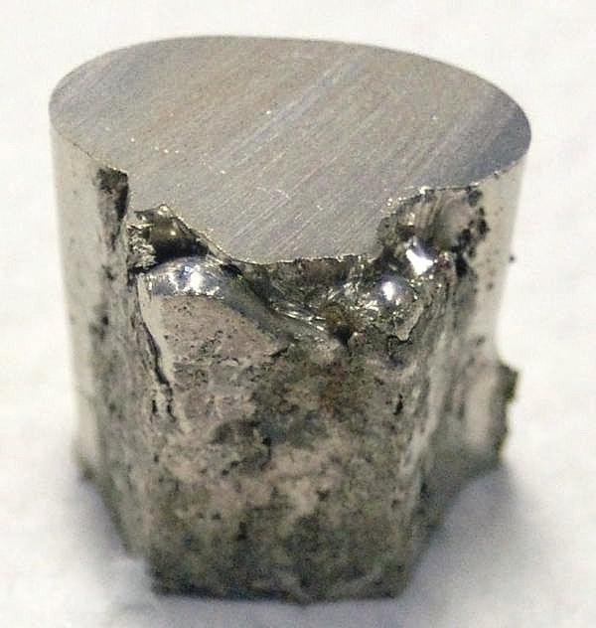
Deep Sea Mineral Deposits
Cobalt
Manganese
Nickel

Slide 8
Rare Earths
Demand for rare earths has leapt from 30,000 tonnes in the 1980s to about 120,000 tonnes in 2010 — higher than the world's current annual production of about 112,000 tonnes
Found in seabed hydrothermal vents and polymetallic nodules
A survey of rare earths in sediments in the Pacific finds that the ocean floor could hold more than 110 million tonnes of rare earths,
Source: Nicola Jones, Sea holds treasure trove of rare-earth elements, Nature (2011)

Slide 9
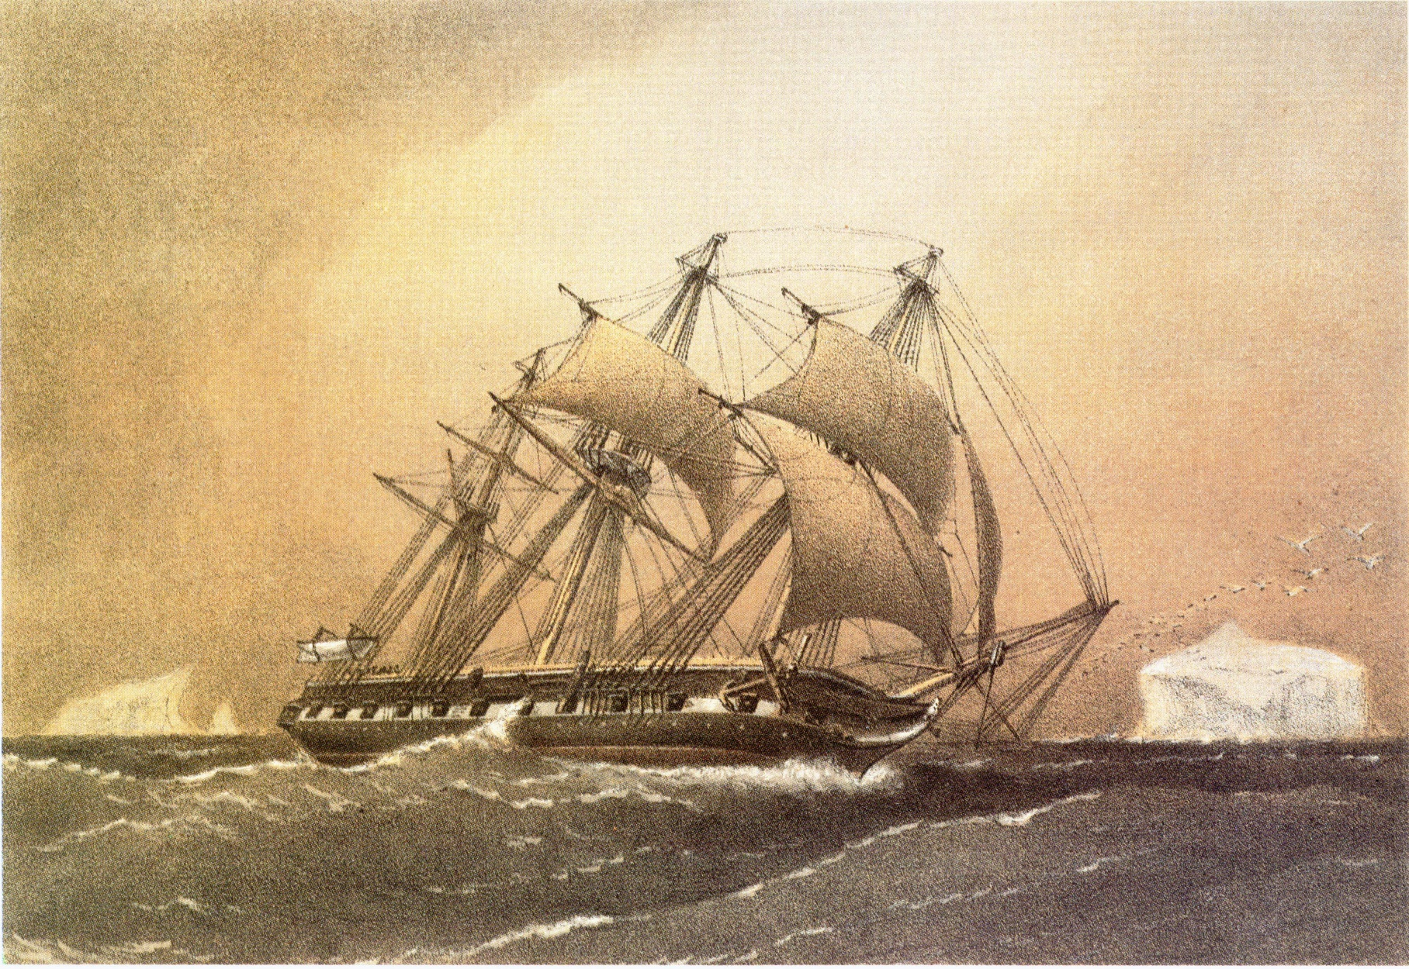
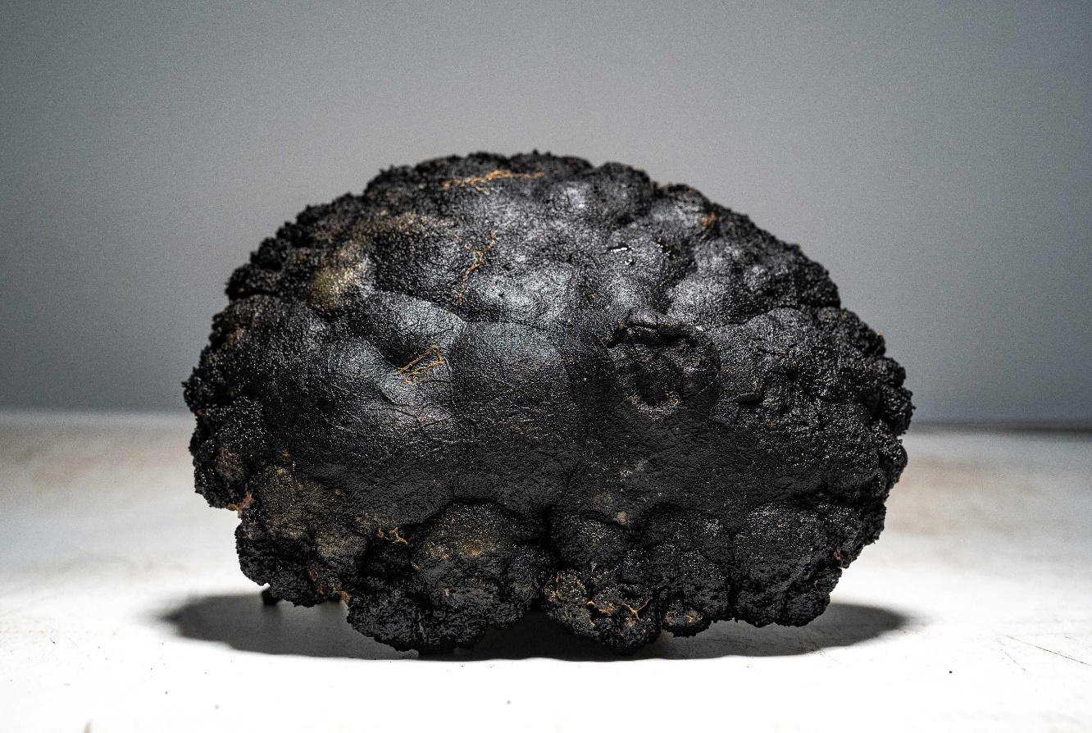
Polymetallic Nodules – History
HMS Challenger

Slide 10
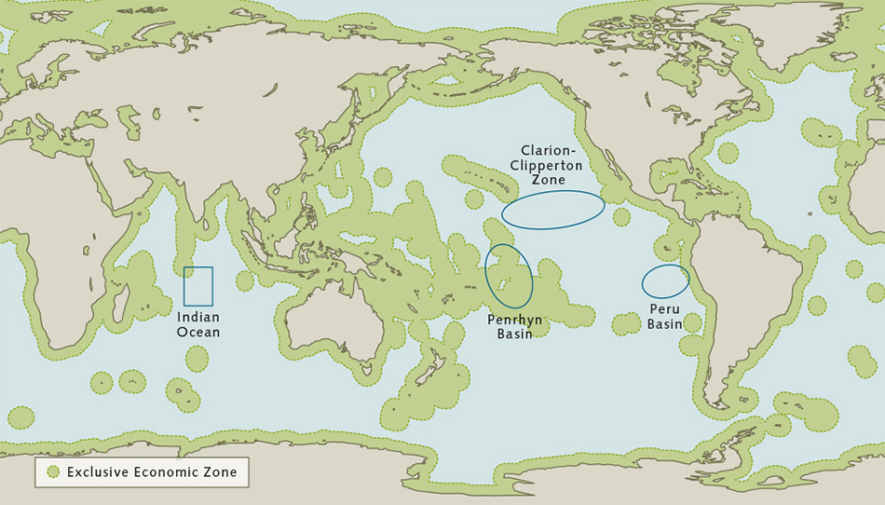
Polymetallic Nodules – Location

Slide 11
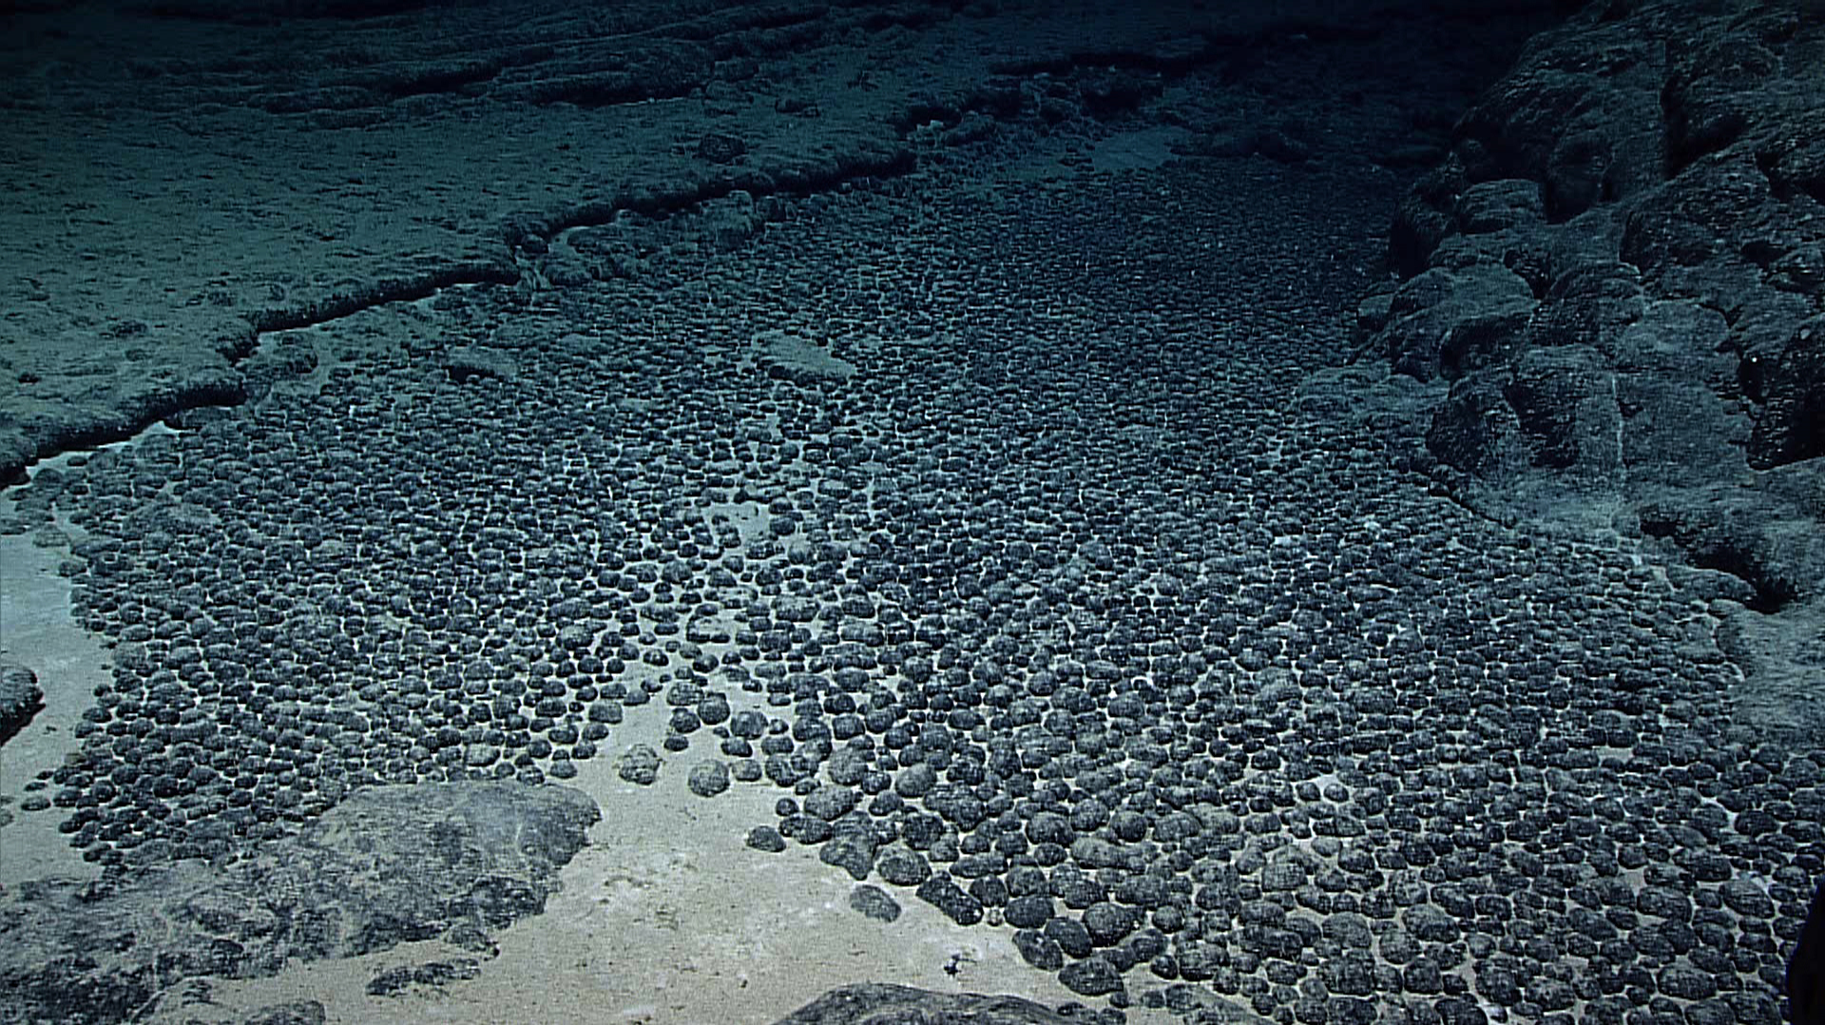
Polymetallic Nodules – Location
Deep-Sea Polymetallic Nodule Field

Slide 12
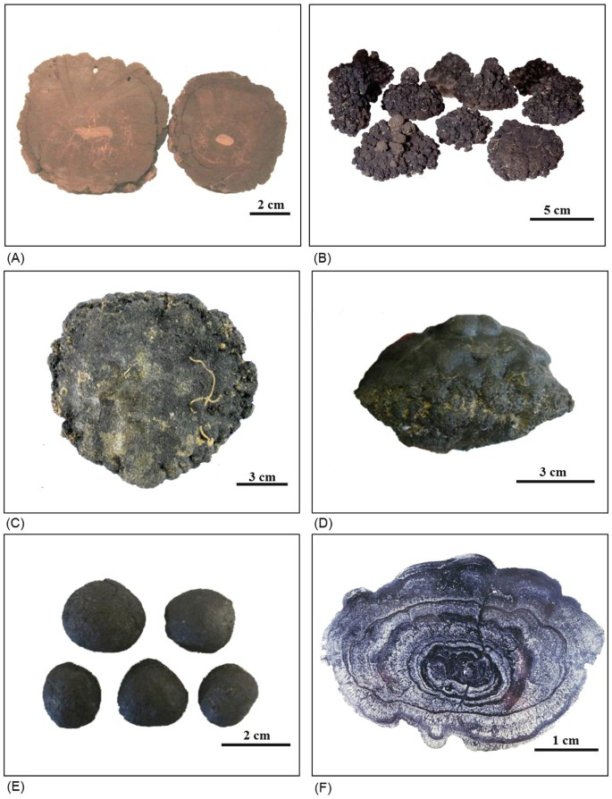
Polymetallic Nodules – Appearance

Slide 13
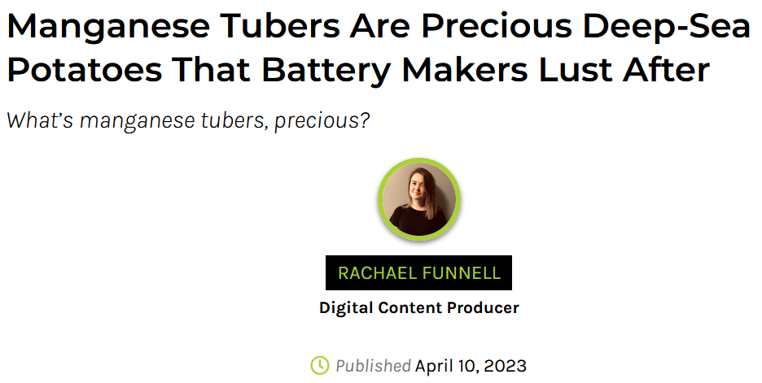
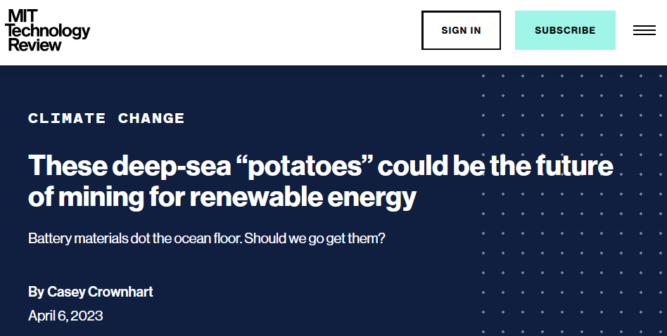
Polymetallic Nodules – Appearance

Slide 14
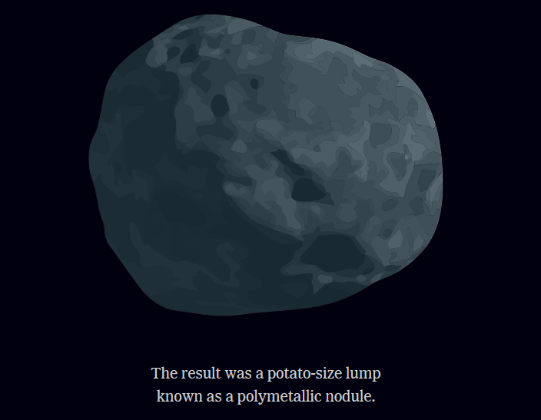
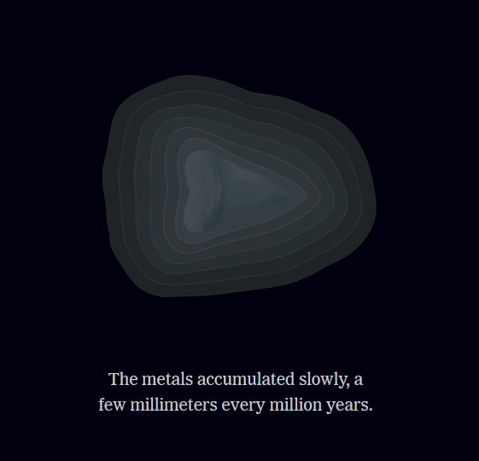
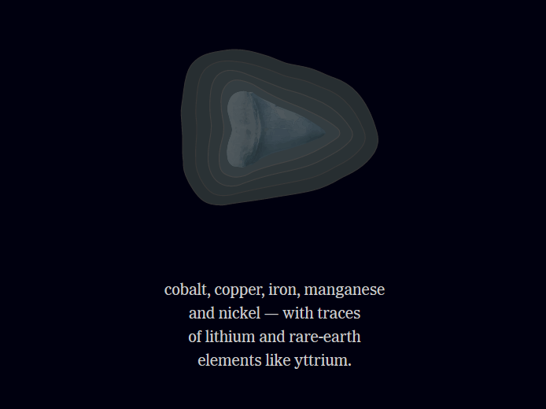
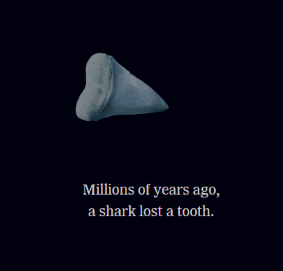
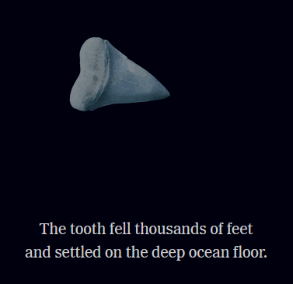
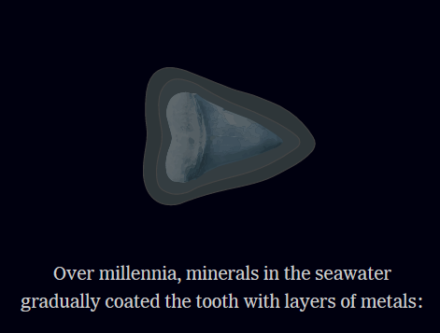
Polymetallic Nodules – Formation
Graphic: New York Times

Slide 15
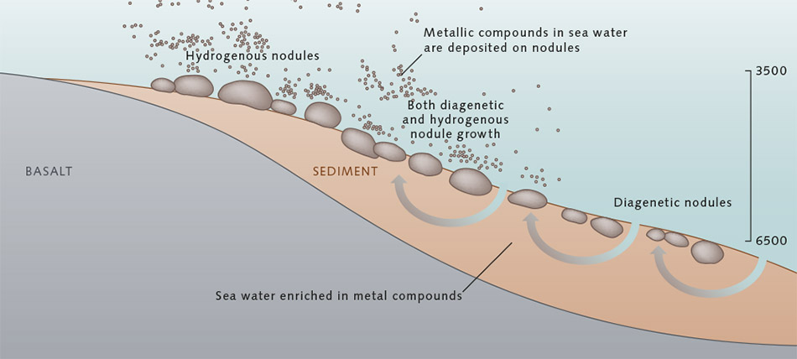
Polymetallic Nodules – Formation

Slide 16
Polymetallic Nodules – Formation

Slide 17
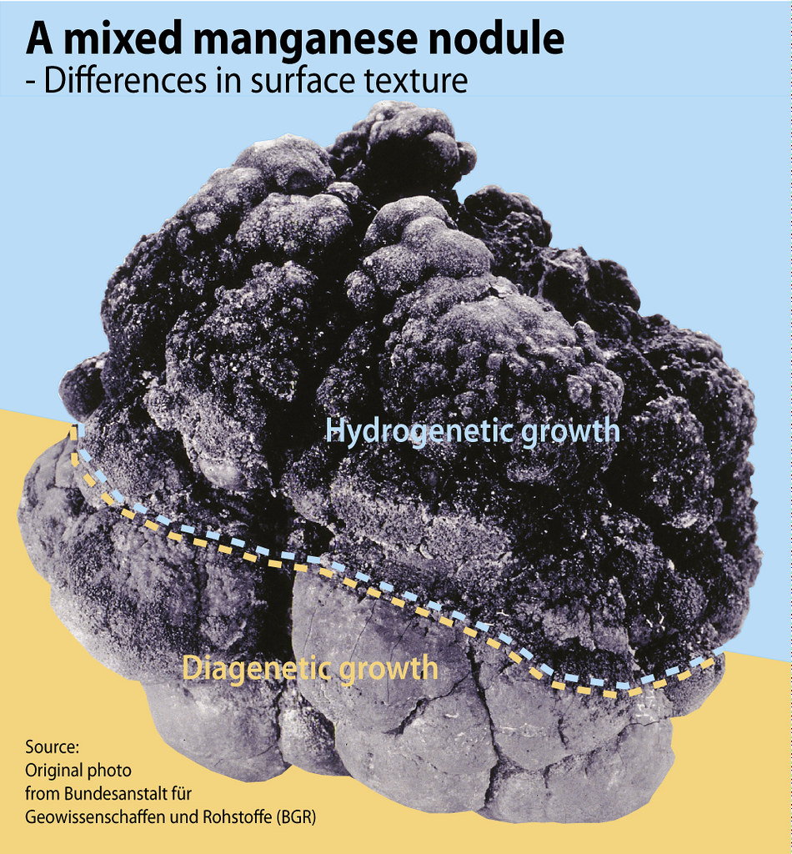
Polymetallic Nodules - Formation

Slide 18
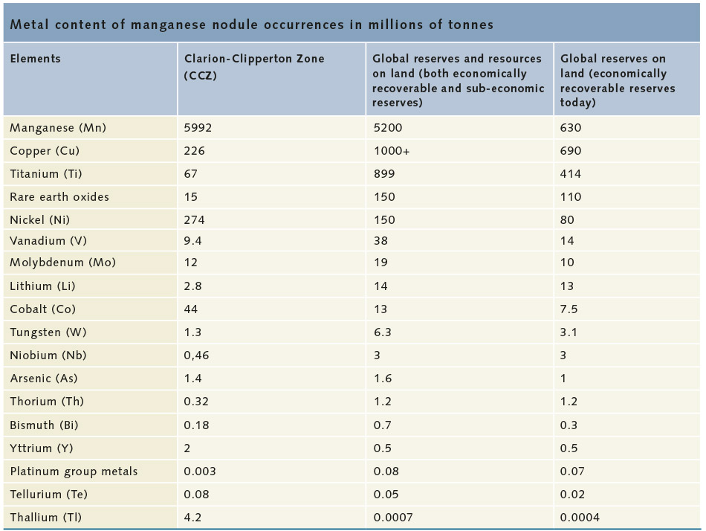
Polymetallic Nodules – Content

Slide 19
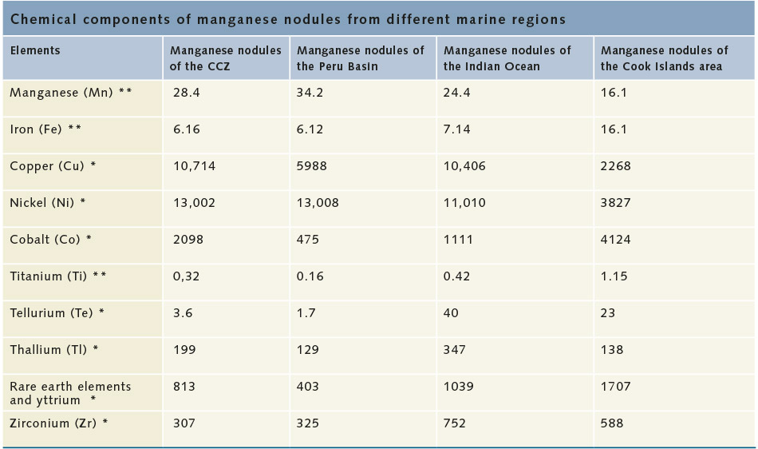
Polymetallic Nodules – Content

Slide 20
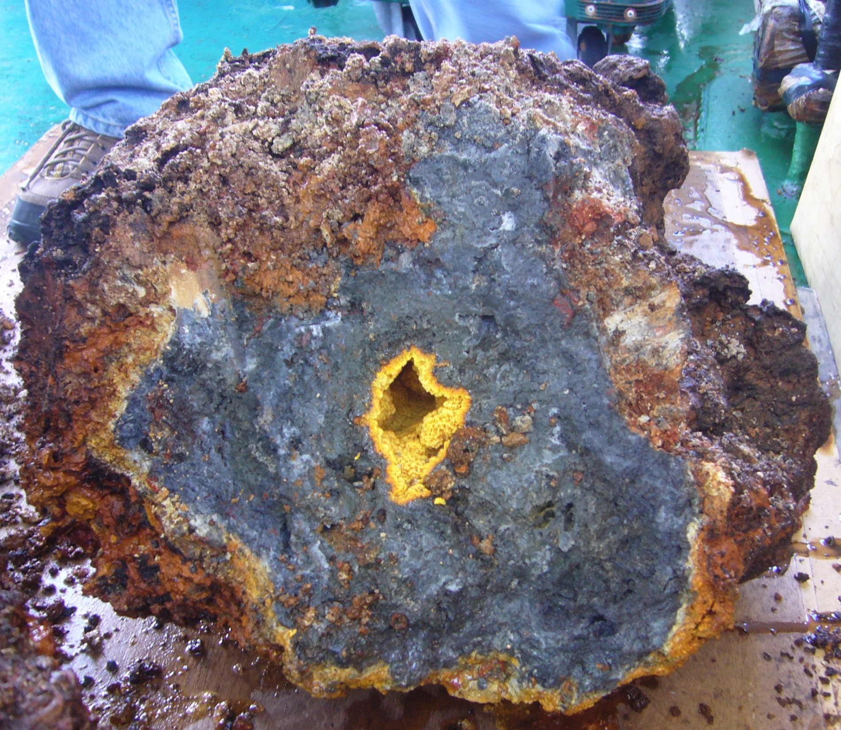
Seafloor Massive Sulfides (SMS)
Cross-section of Hydrothermal Vent Chimney
West Pacific

Slide 21
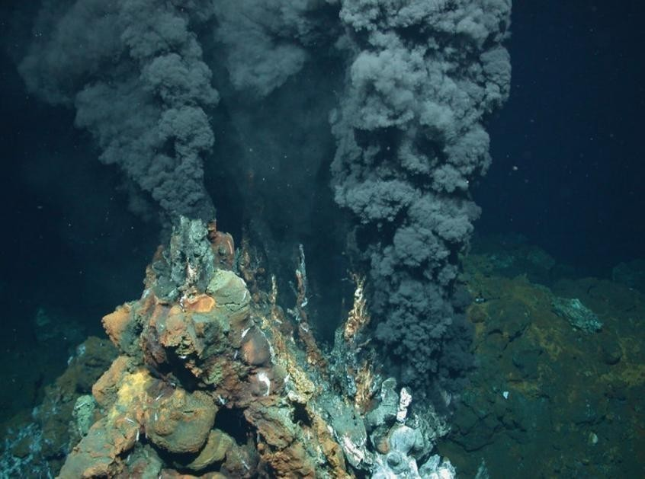
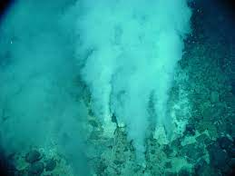
Seafloor Massive Sulfides – “Smokers”
“White Smokers”
“Black Smokers”
Notes:
Seafloor Massive Sulfides
Mineralization is also present around deep sea hydrothermal vents along oceanic ridges. Cold seawater percolates into the seafloor and is warmed by geothermal energy, reaching temperatures in the range of 200 to 400 degrees Celsius. This heated water becomes buoyant and begins to rise, dissolving metals and sulfides along its return to toward the ocean above, ultimately being expelled through seafloor vents. As the expelled, mineral-rich fluid mixes with colder seawater, the minerals precipitate and settle in deposits on the seafloor. Where precipitation occurs rapidly, “chimneys” of mineralization may form, which can then collapse and form sulfide mounds.

Slide 22
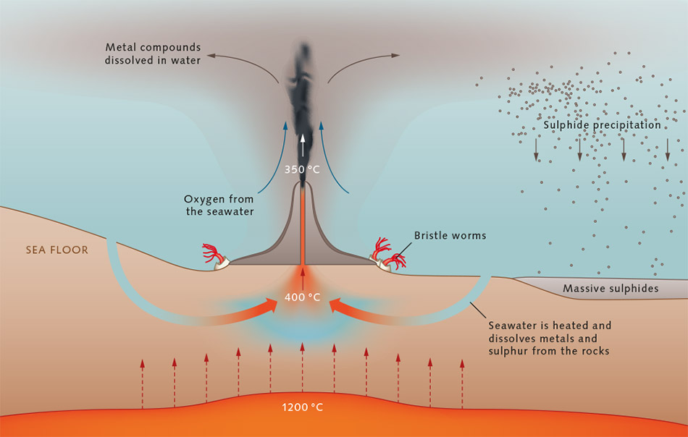
Seafloor Massive Sulfides – Formation

Slide 23
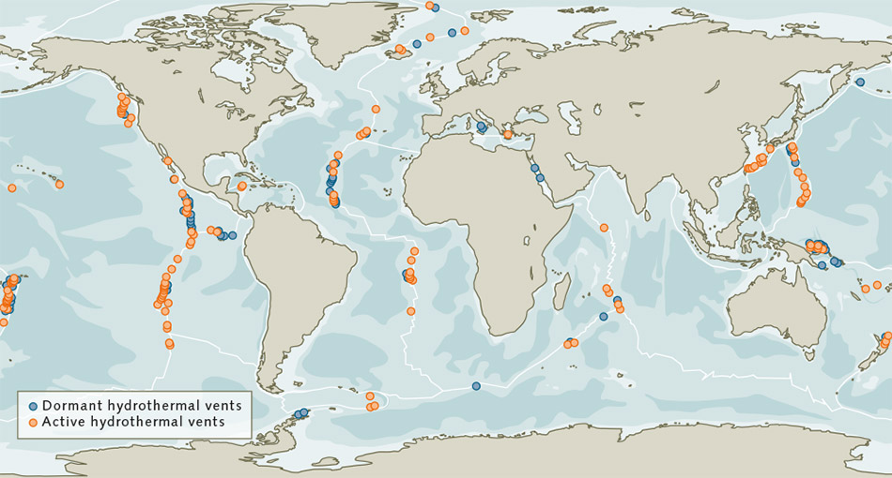
Seafloor Massive Sulfides – Location
Notes:
Seafloor Massive Sulfides
About 65% of SMS have been found along mid-ocean ridges, where tectonic plates meet, while another 12% occur along volcanic arcs and 22% occur along backarc spreading areas near tectonic subduction zones. SMS can be found in every ocean and in some relatively smaller water bodies like the Red Sea and the Mediterranean Sea.
As of 2013, global SMS deposits were estimated to be about 600 million tons, with copper and zinc mass of approximately 30 million tons. Individual deposits vary greatly in size, a fact that may conclusively determine the economic feasibility (or infeasibility) of mining some deposits. The economic and technological feasibility of exploring and mining SMS also depends on the depth of the SMS, which, given their position along oceanic ridges, is generally shallower than the depth of polymetallic nodules.
Depth: 1500 meters to 4000 in the Arctic
Polymetalic nodules are 3500 at the shallowest; as deep as 6000 m

Slide 24
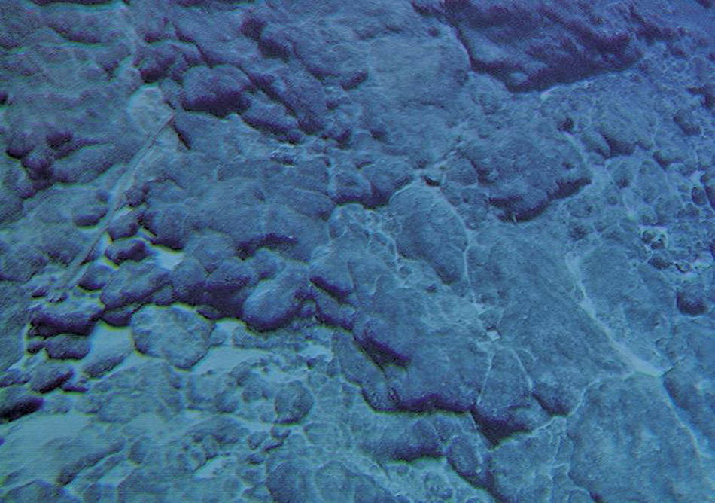
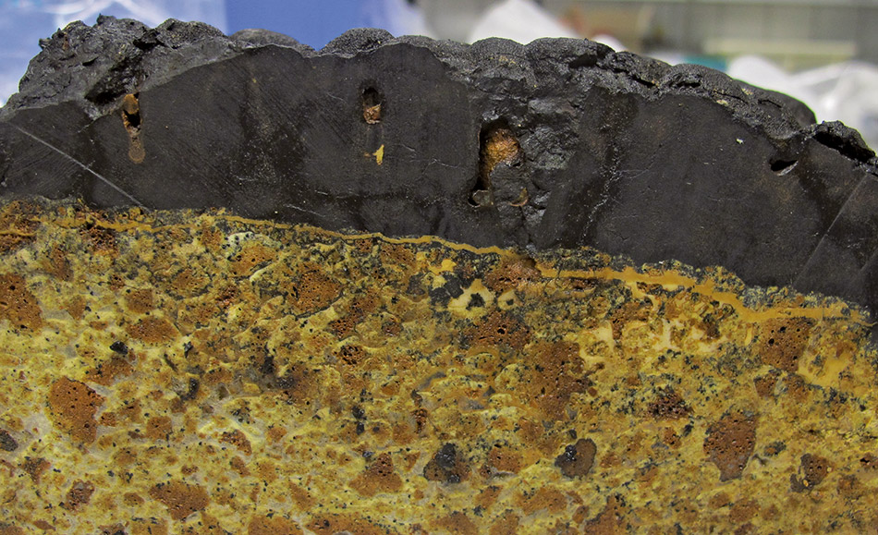
Cobalt-Rich Crusts
Notes:
Cobalt-Rich Crusts
A third potential source of seabed mineralization are cobalt-rich crusts (also referred to as ferromanganese crusts). Depending on location and concentration, crusts can contain economically significant quantities of cobalt, nickel, copper, molybdenum, yttrium, tellurium, and rare earths, among other minerals.

Slide 25
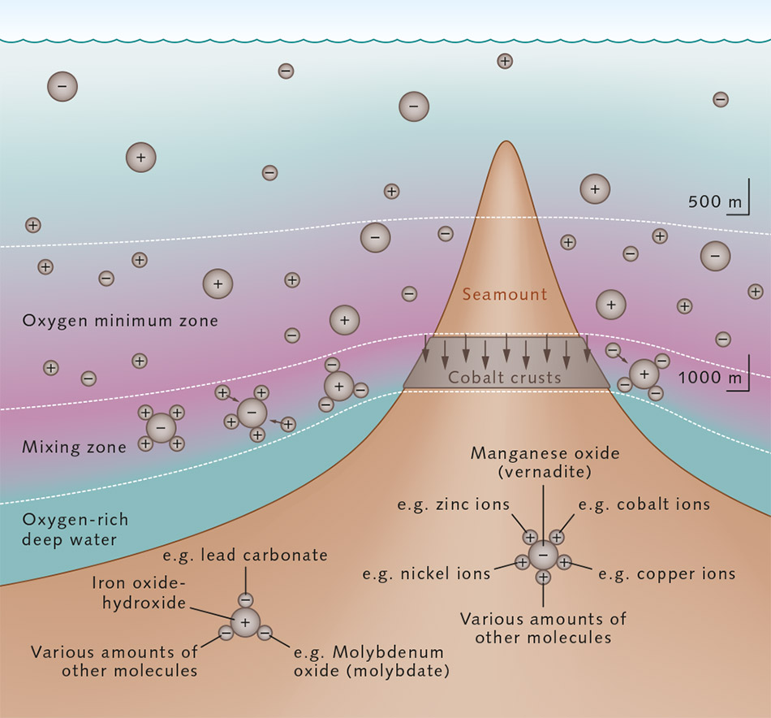
Cobalt-Rich Crusts – Formation
Notes:
These crusts generally form on mid-ocean seamounts (undersea mountains formed by volcanic activity) as iron and manganese precipitate out of cold ocean water and deposit on the slopes and summits of the seamounts. Other minerals are then aggregated from the seawater through the process of adsorption. As with the formation of polymetallic nodules, this process is incredibly slow, occurring at a rate of 1 to 5 millimeters per million years. Crust formation generally requires that the seamount surface be sediment-free, offering a potential explanation for why crusts form less often on flat seafloor terrain. Depending on location and concentration, crusts can contain economically significant quantities of cobalt, nickel, copper, molybdenum, yttrium, tellurium, and rare earths, among other minerals. While cobalt-rich crusts can form at depths between 400 and 4,000 meters, crust thickness and critical mineral concentration vary by depth and location, with the thickest and highest-concentration (and, therefore, the most economically enticing) crusts occurring at depths between 800 and 2,500 meters. Seamounts (of which there are over 30,000 globally) on which crusts might form are distributed throughout the world’s oceans, but are particularly dense in the Pacific Ocean.

Slide 26
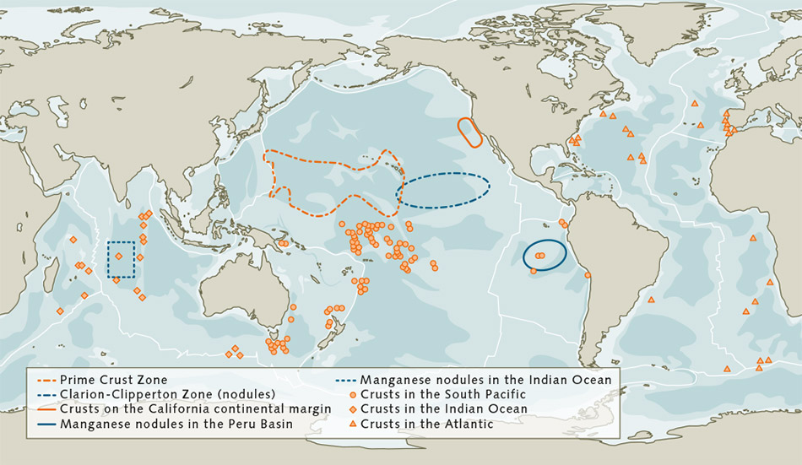
Cobalt-Rich Crusts – Locations
Notes:
Cobalt-Rich Crusts
. Seamounts (of which there are over 30,000 globally) on which crusts might form are distributed throughout the world’s oceans, but are particularly dense in the Pacific Ocean.
When compared to the depths at which polymetallic nodules and SMS occur, the relatively shallow depths of economically valuable cobalt-rich crusts means that such crusts are more likely to be found closer to shore, making it more likely such crusts will fall within a coastal nation’s exclusive economic zone (especially with respect to potential Pacific Ocean crusts, many of which are concentrated near the various island nations within Polynesia, Micronesia, and Melanesia) and outside the jurisdiction of the International Seabed Authority, which is described in greater detail in Section V below.

Slide 27
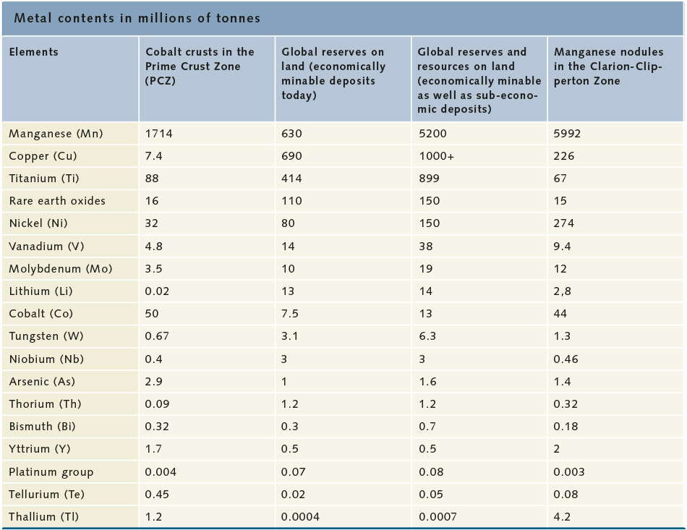
Cobalt-Rich Crusts – Content
Notes:
Cobalt is really the key here. Or at least the one overwhelming mineral

Slide 28
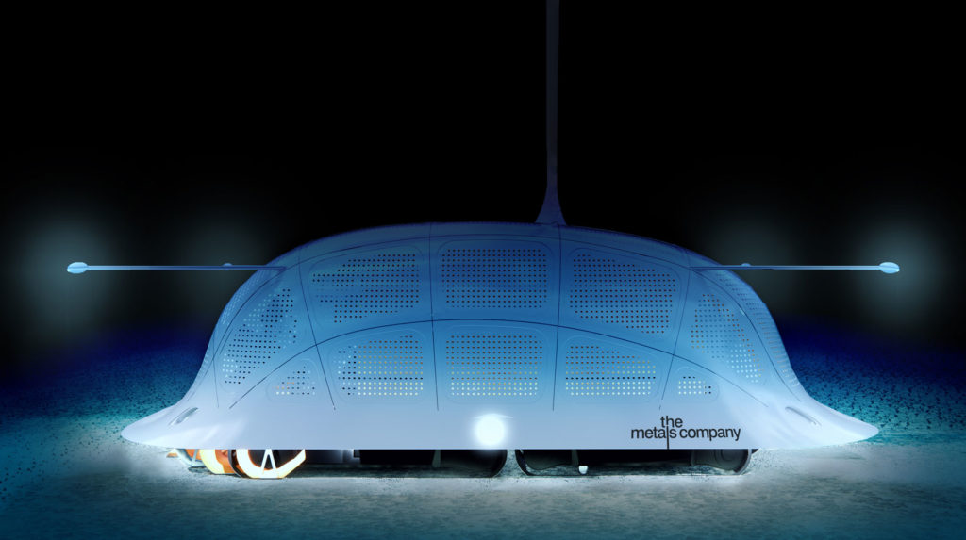
Deep-Sea Mining Methods
Notes:
With respect to recovery of polymetallic nodules, The Metals Company, a mining firm focused on making such operations economically feasible, describes its nodule mining process as follows:

Slide 29
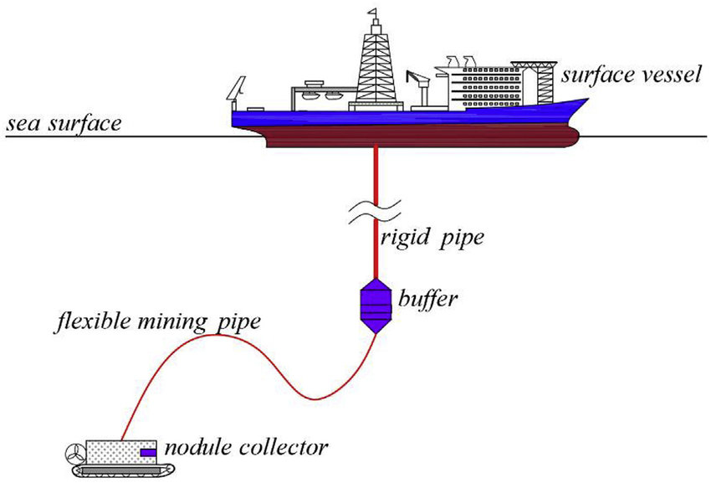
Deep-Sea Mining Methods
Collector System
Lifting System
Support Vessels
Conceptual Polymetallic Nodule Recovery System
Notes:
Deep-Sea Mining Methods
Regardless of whether operations target polymetallic nodules, SMS, or cobalt-rich crusts, all deep-sea mining activities currently share three characteristics: a collector system, a lifting system, and support vessels.
With respect to recovery of polymetallic nodules, The Metals Company, a mining firm focused on making such operations economically feasible, describes its nodule mining process as follows:
Our production process begins with the collector, designed to collect polymetallic nodules from the abyssal seafloor. Over 90% of the entrained sediment is expected to be separated from the nodules inside the collector and discharged behind it, with most sediment settling back to the seafloor within a few hundred meters. From the collector, nodules travel up a riser system to our production vessel. Once aboard, nodules get dewatered and residual water, sediment and nodule fines will be returned below the photic zone to a depth scientifically chosen to have minimal impact on the collection area.

Slide 30
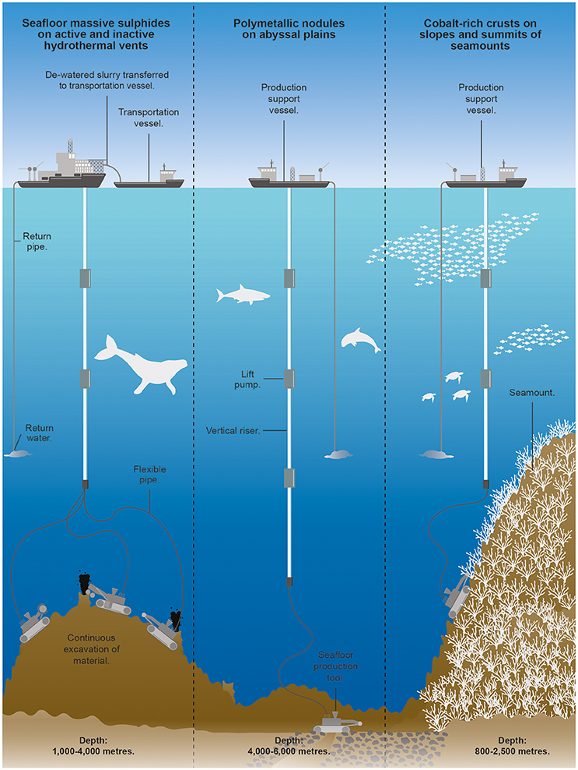
Deep-Sea Mining Methods

Slide 31
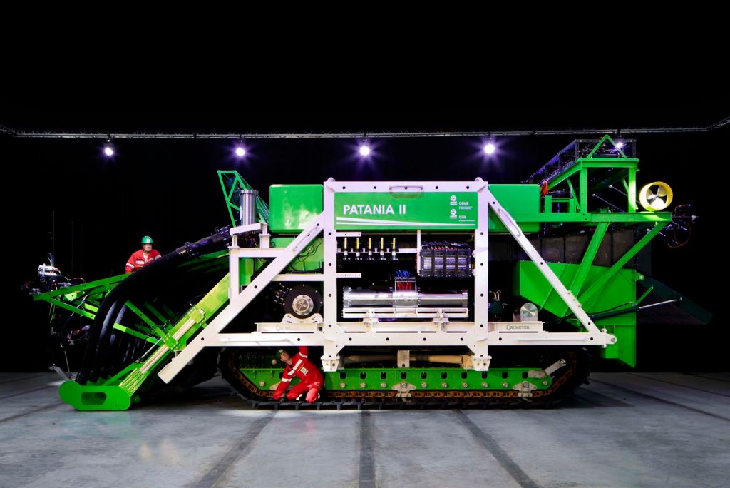
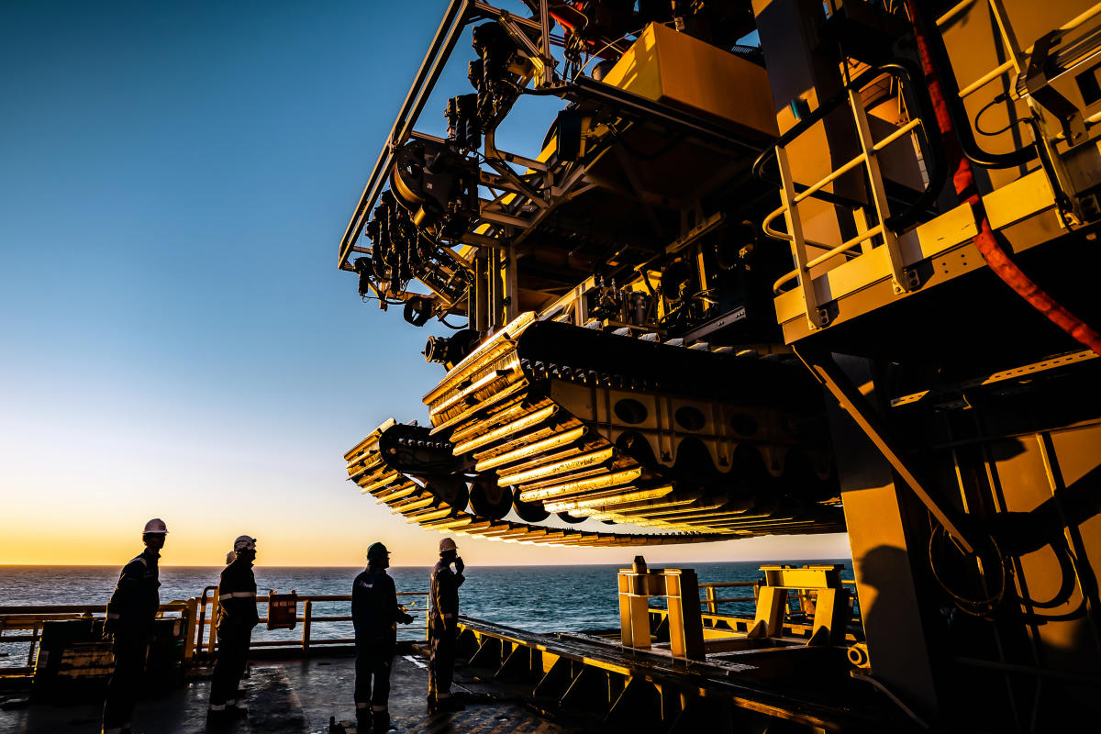
Deep-Sea Mining Technologies

Slide 32
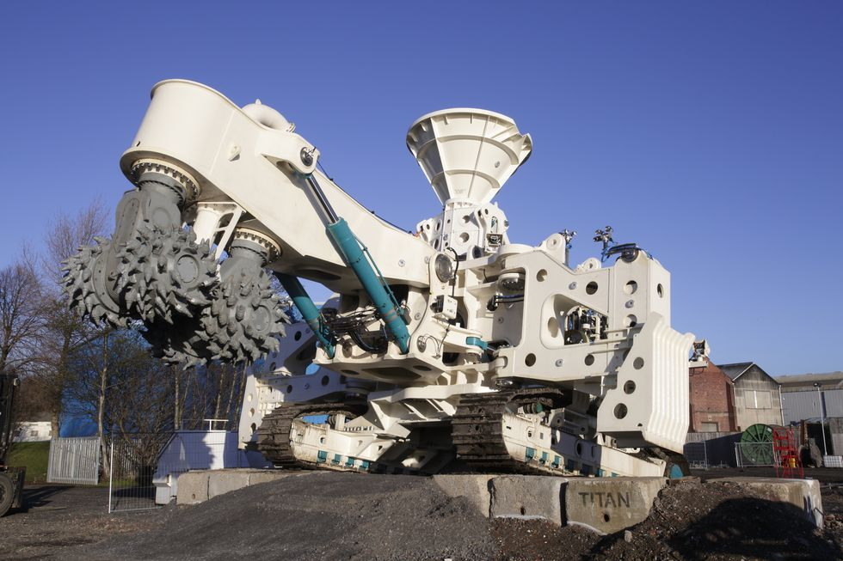
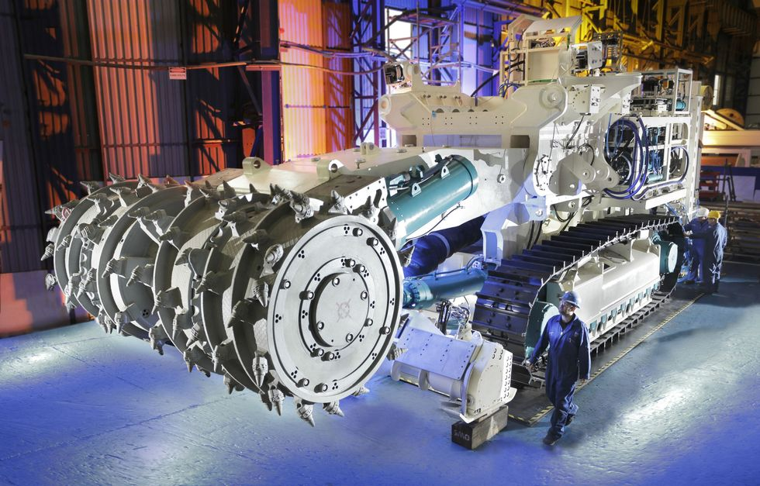
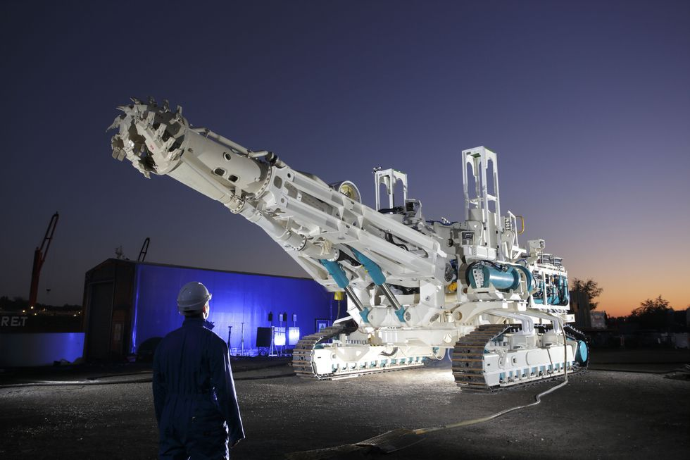
Deep-Sea Mining Technologies
Auxiliary Cutter
Bulk Cutter
Collecting Machine

Slide 33
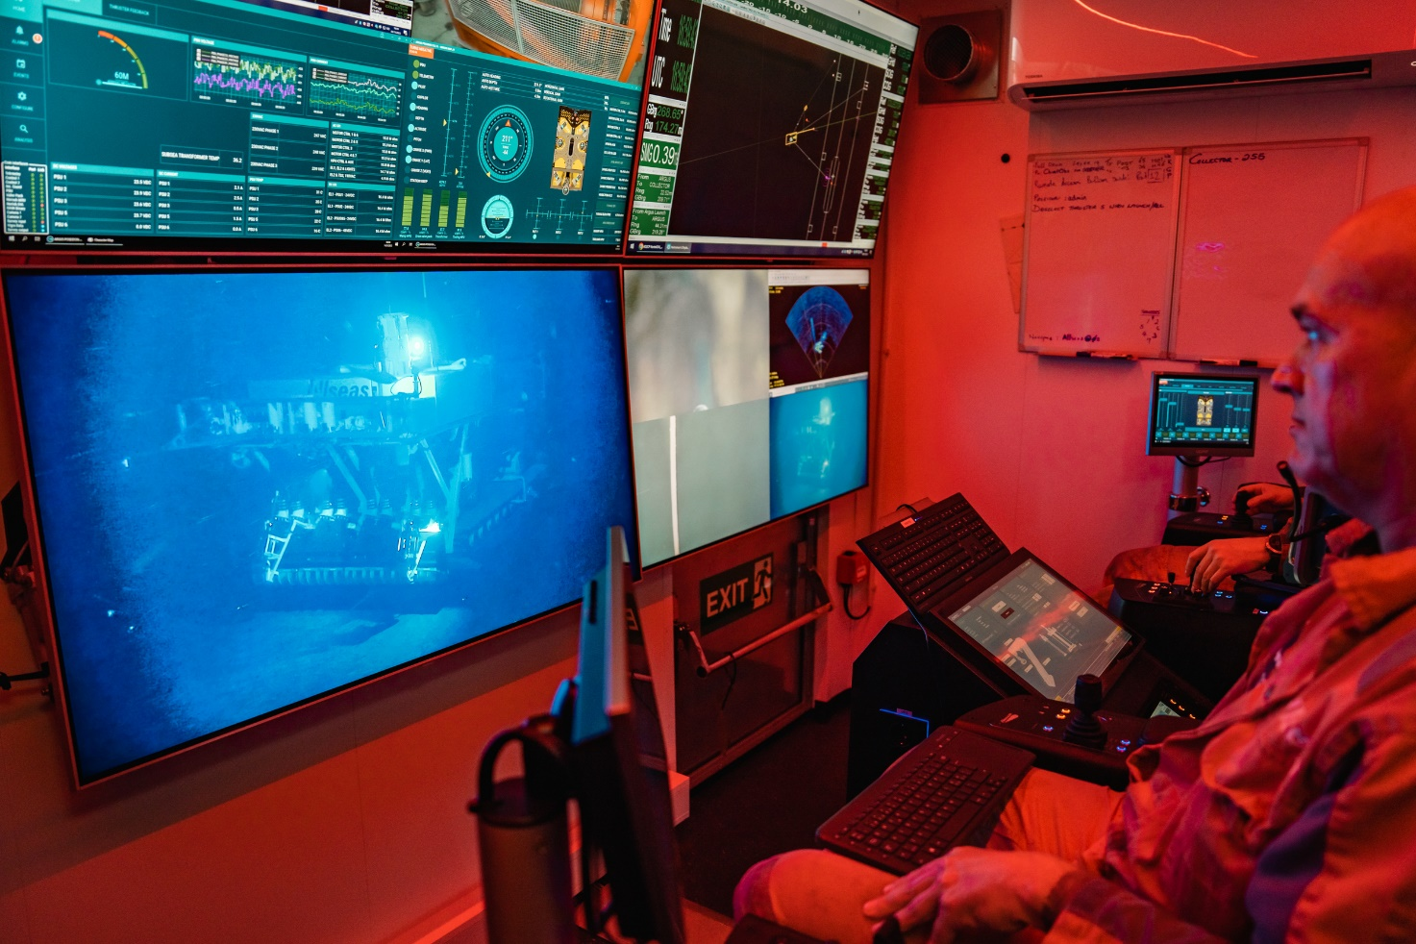
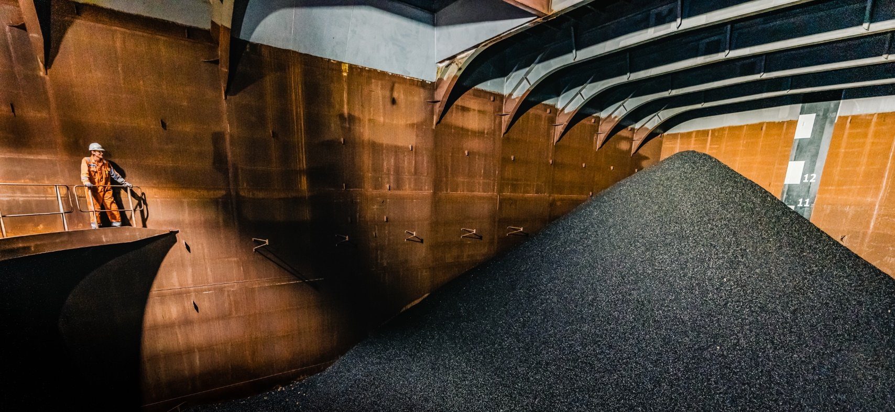
Deep-Sea Mining Technologies

Slide 34
Deep-Sea Mining Technologies
Notes:
Processing is a critical element of the feasibility analysis

Slide 35
The Law of the Sea
Grotius – Mare Liberum (1608):
Under natural law, the sea is the common property of mankind
Ships of every nation are free to sail the high seas.
Notes:
Dutch ships attack and capture Portuguese ship loaded with booty – the Santa Catarina. Near modern Singapore.
Arguably an act of piracy, but Grotius develops his theory to justify the act because the Portuguese were controlling the high seas and the spice trade – in violation of the law of the sea.

Slide 36
United Nations Convention on the Law of the Sea (UNCLOS)
1958 Conference on the Law of the Sea – adopts four conventions
Third conference in 1982 results in UNCLOS
UNCLOS effective November 16, 1994
UNCLOS based on customary international law of the sea
Establishes International Seabed Authority (ISBA)

Slide 37
The United States and UNCLOS
The United States has not signed or ratified UNCLOS
US objects to provisions related to mineral resources development
US subsequently signed an agreement that addresses those concerns

Slide 38
Maritime Zones under UNCLOS
Tufts, Law of the Sea: A Policy Primer, Ch. 2 (2023)
Notes:
The UNCLOS allocation of jurisdiction starts on the land and moves seaward. The boundary where the land ends and the territorial sea begins, as defined by the low water line on the coast, is described in UNCLOS as the “baseline.” Setting the baseline may be affected by the nuances of reefs and bays and river mouths.
A coastal State may exercise some control over a “contiguous zone,” which may not be greater than 24 miles from the baseline. Within the contiguous zone, a coastal State may enforce “its customs, fiscal, immigration or sanitary laws and regulations.”
A coastal State retains some jurisdiction over its exclusive economic zone (EEZ). Those rights include the development of natural resources (living and non-living) and the use of currents and wind for energy production. The EEZ can extend 200 miles from the baseline. A coastal State may also exercise jurisdiction over resource development beyond the EEZ where its continental shelf extends past the 200-mile limit of the EEZ. A coastal State has the sovereign right to explore and exploit natural resources on its continental shelf. The “continental shelf” is the portion of the seabed that is “the natural prolongation of [a State’s] land territory to the outer edge of the continental margin.” The “continental margin,” in turn, “comprises the submerged prolongation of the land mass of the coastal State, and consists of the seabed and subsoil of the shelf, the slope and the rise. It does not include the deep ocean floor with its oceanic ridges or the subsoil thereof.”

Slide 39
Determining the Continental Shelf
Notes:
A State is required to determine the outer edge of its continental margin and can map it using straight lines of no more than 60 nautical miles. When making this determination, a State has the option of using one of two tests for determining the continental margin: the Gardiner formula or a modified version of the Hedberg proposal. In most circumstances, the continental margin slopes gently away from land, and then slopes down more sharply to the seabed. The continent continues below the seabed for some distance. Under the Gardiner formula, the continental margin ends at the outermost point where the thickness of sedimentary rock on the sea floor is at least 1% of the distance from such point to the base of the continental slope. “If the formula is to be applied to a point at, say for example, 100 M from the foot of the slope, the sedimentary thickness at that point should be 1 M thick.” Under the modified Hedberg proposal, the continental margin ends 60 nautical miles from the base of the continental slope. Regardless of the outcome of this calculation, the extended continental shelf may not, for the purposes of UNCLOS, extend beyond either (1) 350 miles from the baseline or (2) 100 miles beyond the point where the ocean depth is 2,500 meters.
Where mineral development occurs beyond the 200-mile EEZ, however, UNCLOS provides that the coastal State must make “payments or contributions in kind” to the ISBA after the first five years of mineral production. The U.S. Extended Continental Shelf Project has as its mission “to establish the full extent of the continental shelf of the United States, consistent with international law.” For the U.S. Department of State, “consistent with international law” means customary international law, as reflected in UNCLOS. Even though the United States is not a party to UNCLOS, it follows the general principles set out in UNCLOS when asserting jurisdiction over its extended continental shelf.
The “high seas” are the parts of the ocean beyond any territorial sea or the EEZ. “The Area” is “the seabed and ocean floor and subsoil thereof, beyond the limits of national jurisdiction.” In other words, the Area is the bottom of the high seas, and it is the Area, and the rules that apply to the Area, that are the current focus of mineral development.

Slide 40
Notes:
Norway has paused its controversial project to open up its seabed for commercial-scale deep-sea mining.
Oslo had planned to let companies apply to mine 280,000 sq km (108,000 sq miles) of its waters for precious metals - an area bigger than the size of the UK.
The move was blocked after the country’s Socialist Left Party said it would not support the government’s budget unless it scrapped the first licensing round, set for 2025.

Slide 41
South China Sea
Notes:
China’s sweeping claims of sovereignty over the sea—and the sea’s estimated 11 billion barrels of untapped oil and 190 trillion cubic feet of natural gas—have antagonized competing claimants Brunei, Indonesia, Malaysia, the Philippines, Taiwan, and Vietnam. As early as the 1970s, countries began to claim islands and various zones in the South China Sea, such as the Spratly Islands, which possess rich natural resources and fishing areas.
China maintains [PDF] that, under international law, foreign militaries are not able to conduct intelligence-gathering activities, such as reconnaissance flights, in its exclusive economic zone (EEZ). According to the United States, claimant countries, under UN Convention of the Law of the Sea (UNCLOS), should have freedom of navigation through EEZs in the sea and are not required to notify claimants of military activities. In July 2016, the Permanent Court of Arbitration at The Hague issued its ruling on a claim brought against China by the Philippines under UNCLOS, ruling in favor of the Philippines on almost every count. While China is a signatory to the treaty, which established the tribunal, it refuses to accept the court’s authority.
In recent years, satellite imagery has shown China’s increased efforts to reclaim land in the South China Sea by physically increasing the size of islands or creating new islands altogether. In addition to piling sand onto existing reefs, China has constructed ports, military installations, and airstrips—particularly in the Paracel and Spratly Islands, where it has twenty and seven outposts, respectively. China
has militarized Woody Island by deploying fighter jets, cruise missiles, and a radar system

Slide 42
UNCLOS and Resource Development
UNCLOS Part XI
Develop resources “to foster healthy development of the world economy and balanced growth of international trade, and to promote international cooperation for the over-all development of all countries, especially developing States.”

Slide 43
Part XI
Exploration
Exploitation
Plan of Work
Assessment of Environmental Impacts
Contracts
The Enterprise
seatools.com
Notes:
The “Enterprise” is intended to be the operational organ of the ISBA, and its specified activities include “the transporting, processing and marketing of minerals recovered from the Area.” The Enterprise can directly engage in mineral development in the Area. The Enterprise can propose a plan of work for mineral resource development in the Area. The Enterprise can also enter into joint ventures with other companies or State actors developing mineral resources in the deep sea.
The Part XI Agreement recognizes that the Enterprise is not a fully functioning commercial entity. The Agreement allows the ISBA to perform the functions of the Enterprise. It also provides for the Enterprise to conduct its initial seabed mining operations through joint ventures. Where a contractor has worked in an area, it has a right of first refusal to enter into a joint venture with the Enterprise, and if the Enterprise has not submitted a plan of work for the area, the contractor must nonetheless make a good faith offer to the Enterprise to participate in a joint venture for that area.
There was a push to eliminate the Enterprise during the development of the seabed mining regime, and while the Enterprise remains in place, its operations were curtailed.

Slide 44
Part XI Agreement
Part XI Agreement (1994) modifies the resource development provisions of UNCLOS
Signed by United States, but still no ratification of UNCLOS
Provisional application

Slide 45
Key terms of the Part XI Agreement
The United States is guaranteed a seat on the International Seabed Authority’s executive council;
The voting power of the United States is enhanced;
Market-based production regime for seabed minerals is instituted;
Mandatory transfer of technology is eliminated;
Access for private companies is enhanced
Regulatory burden on the industry is reduced

Slide 46
Royalties
Common Heritage of Mankind
Resources:
vested in mankind as a whole
Not subject to alienation
Can take title to extracted minerals

Slide 47
Royalties
Under Part XI
Choose production charge or combination of production charge and share of net proceeds
Polymetallic nodules:
Fixed percentage of 5% for 10 years, 12% thereafter
Combination: 2% then 4% and a portion of net proceeds
Part XI Agreement deletes royalty provisions
Will be addressed in regulations

Slide 48
Gaps in Part XI Agreement
Gaps will be filled by exploitation regulations
Draft exploitation regulations have been drafted
But – seabed mining remains contentious
Some countries recommend delaying adoption of the regulations.
Photo credit: International Seabed Authority.

Slide 49
Exploration
Existing Exploration Regulations
ISBA has issued exploration contracts to 15 companies
31 total contracts:
nineteen for polymetallic nodules in the Clarion-Clipperton Fracture Zone (17) and Central Indian Ocean Basin (1), and Western Pacific Ocean (1).
seven (7) contracts for exploration for polymetallic sulphides in the South West Indian Ridge, Central Indian Ridge and the Mid-Atlantic Ridge
five (5) contracts for exploration for cobalt-rich crusts in the Western Pacific Ocean

Slide 51
Draft Exploitation Regulations
Draft developed March 2019
New Consolidated Draft circulated February 2024
Under review and comment
Process:
Apply for approval of Plan of Work
Technical, financial and environmental plans and studies
If approved, contract for exploitation area
30-year term, ten-year renewals
Continuous operation, subject to market economics
Annual fees and a royalty. Numbers are undetermined at present.
Environmental performance guarantee

Slide 52
The July Deadline – Nauru

Slide 53
Paragraph 15
Paragraph 15 of the first annex to the Part XI Agreement directs the ISBA to adopt the mining regulations contemplated by Article 162(o)(ii) in order to “facilitate the approval of plans of work for exploration or exploitation.”
ISBA to issue regulations within two years of a request by any member
Provisional approval of a plan of work at the end of that two-year period if the regulations have not been completed

Slide 54
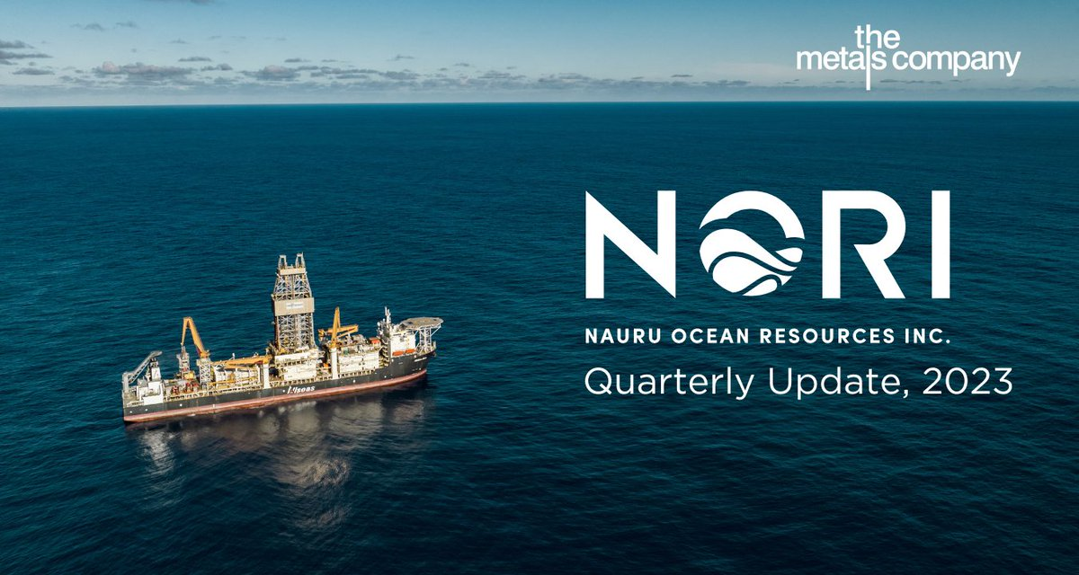
NORI
Nauru Ocean Resources, Inc. (“NORI”) sponsored by the Republic of Nauru
Subsidiary of The Metals Company (TSX listed)
The Republic of Nauru formally notified the ISBA in 2021 that Nauru and NORI planned to begin mining activities in the deep sea
Regulations must be issued by July 2023
If not, then NORI has provisional approval of its plan of work
(. . . it appears)

Slide 55
July 2023
Notes:
As of mid-2021, action has been forced under Paragraph 15, requiring draft exploitation regulations to be finalized by July 9, 2023. Specifically, citing Paragraph 15, the President of Nauru, H.E. Mr. Lionel Aingimea, sent a letter to the ISBA dated June 25, 2021, requesting adoption of the regulations contemplated by Article 162(o)(ii) of UNCLOS and noting that Nauru Ocean Resources, Inc. (NORI), a subsidiary of The Metals Company sponsored by the Republic of Nauru, would apply for approval of a plan of work in the Area in connection with its deep-sea exploration rights. The ISBA Counsel met from July 10 to July 21,and the ISBA Assembly met from July 24 to July 28, and did not finalize the exploitation regulations. The Council stated that it intends to continue the elaboration of the exploitation regulations with a view to their adoption at the 30th session of the Authority in 2025, although that 2025 date is an indicative target and not a deadline.
Given that Paragraph 15 requires provisional approval of NORI’s plan of work if the regulations are not complete within two years of its request, NORI has arguably accrued the right to have its plan of work implemented.. The Metals Company, a Vancouver, British Columbia-based deep-sea mining company, could potentially also see corresponding progress through its two other subsidiaries: Tonga Offshore Mining Limited, sponsored by the Kingdom of Tonga, and DeepGreen Engineering Pte., Ltd., which has an arrangement with a State-owned company sponsored by the Republic of Kiribati. The Metals Company issued a statement indicating that NORI will submit its application for approval of its plan of work in July 2024, following the ISBA working session on the regulations scheduled for that month.

Slide 57
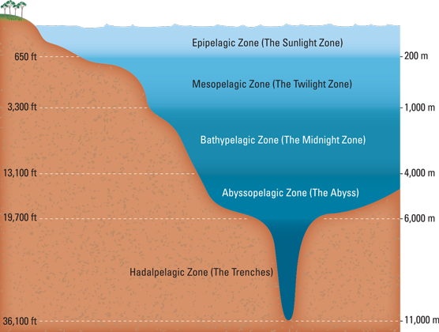
The Deep Sea Environment
Notes:
The Deep Sea Environment
The ocean is broadly divided into five zones by depth:
• Epipelagic Zone (0-200 meters), or “Sunlight Zone”
• Mesopelagic Zone (200-1,000 meters), or “Twilight Zone”
• Bathypelagic Zone (1,000-4,000 meters), or “Midnight Zone”
• Abyssopelagic Zone (4,000-6,000 meters), which includes the abyssal plain
• Hadalpelagic Zone (6,000-11,000 meters), which includes ocean trenches

Slide 58
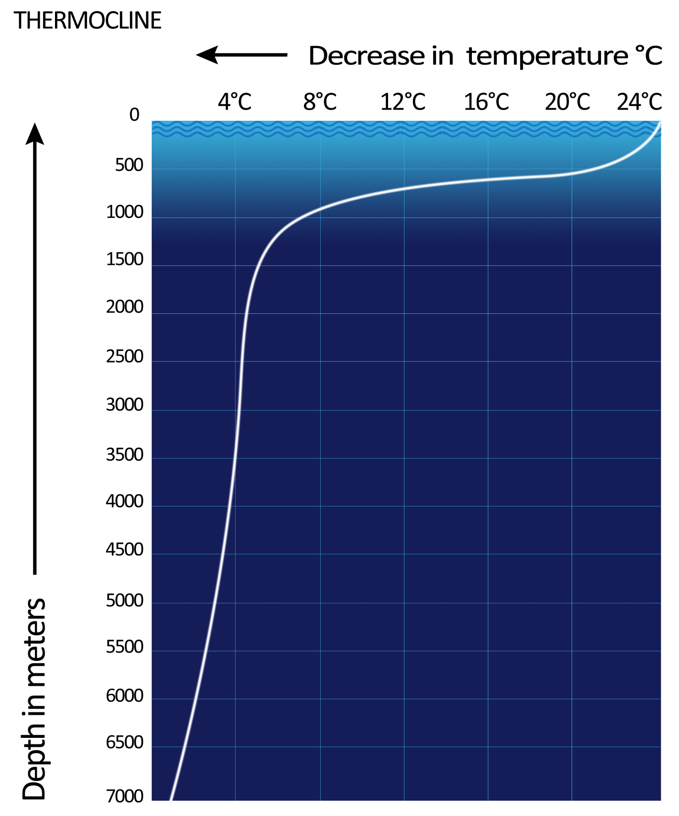
The Deep Sea Environment
Pressure Change
1 atmosphere per 10 meters
Notes:
As depth increases, so too does water pressure, which ramps up at a rate of 1 atmosphere (14.7 pounds per square inch) per 10 meters of depth. Temperature generally falls at greater depths, with water temperatures reaching about 39 degrees Fahrenheit in the Bathypelagic Zone.

Slide 59
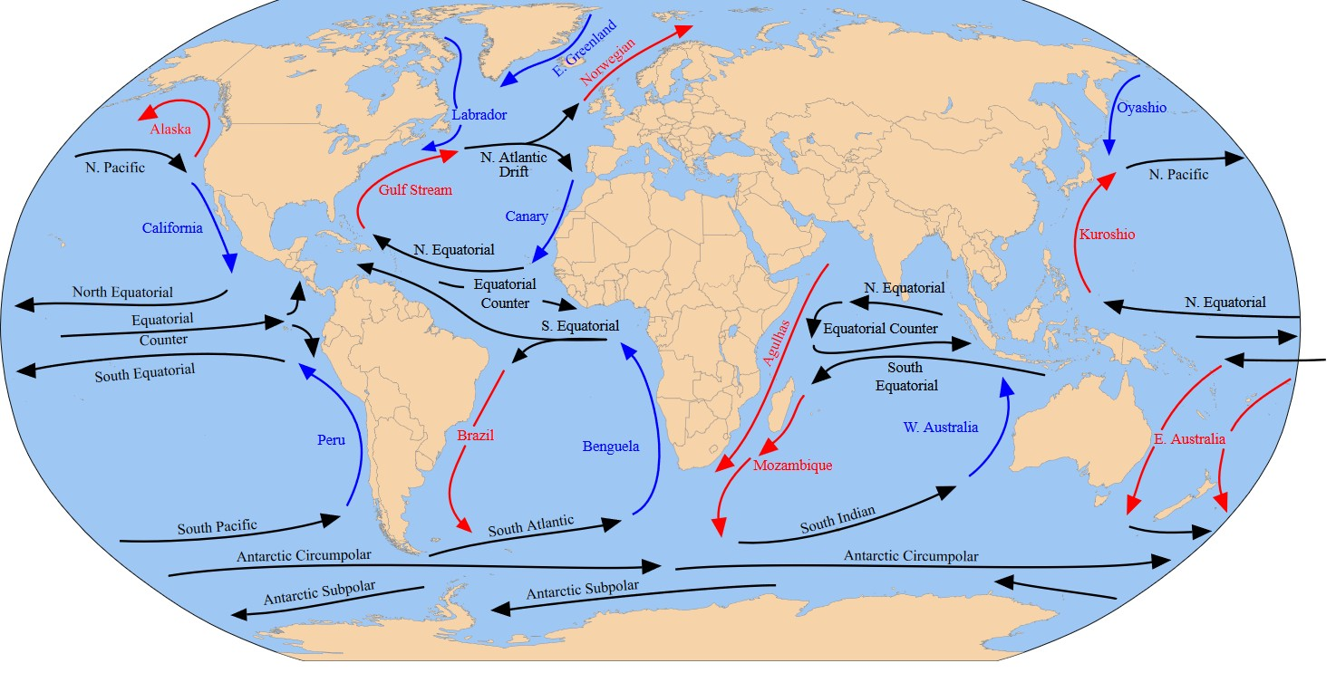
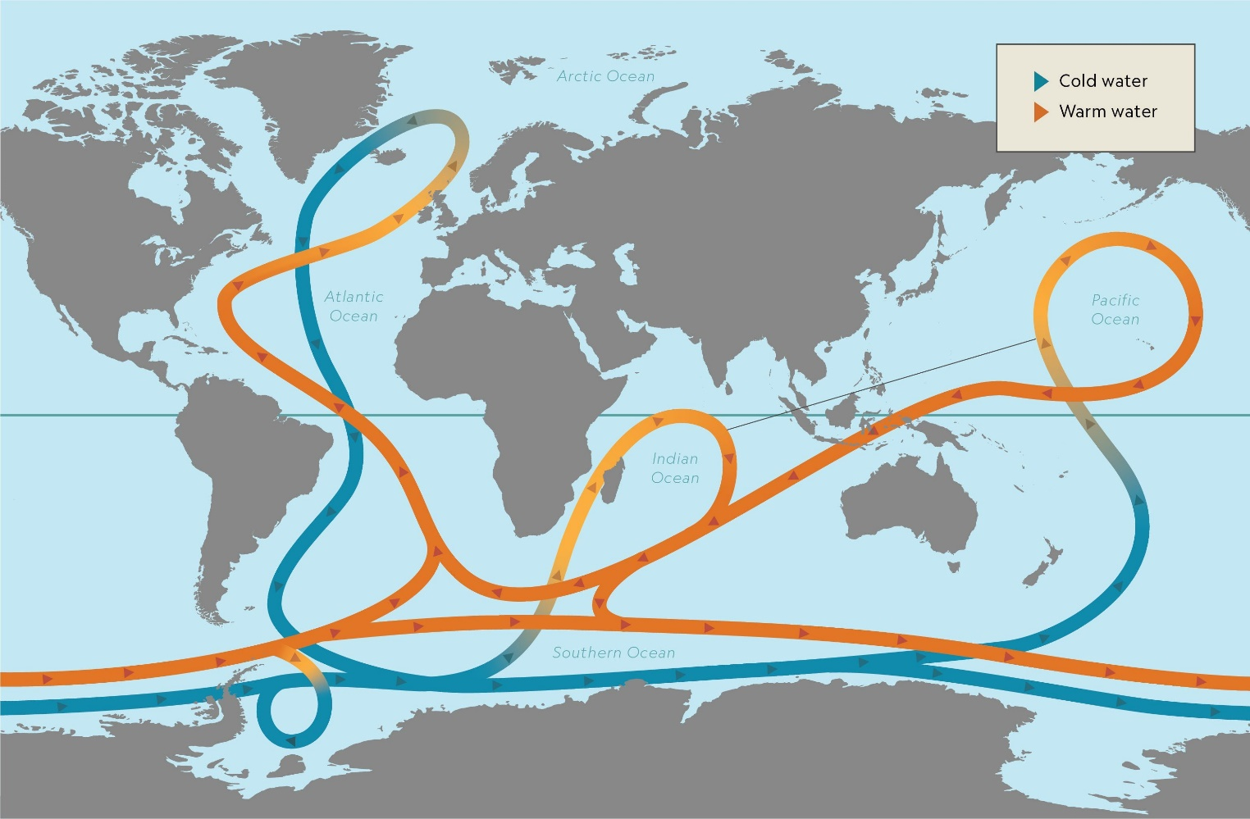
Surface and Deep-Sea Currents
Surface Currents
Deep-Sea Currents
(Thermohaline Circulation)
Notes:
While ocean currents in shallower ocean zones are largely powered by surface winds, deep sea currents are driven by water temperature and density through the process of thermohaline circulation. The speed of deep sea currents is usually a mere few centimeters per second, creating a stiller, more stable environment; surface currents, in contrast, can reach up to 250 centimeters per second, or about 9 kilometers per hour.

Slide 60
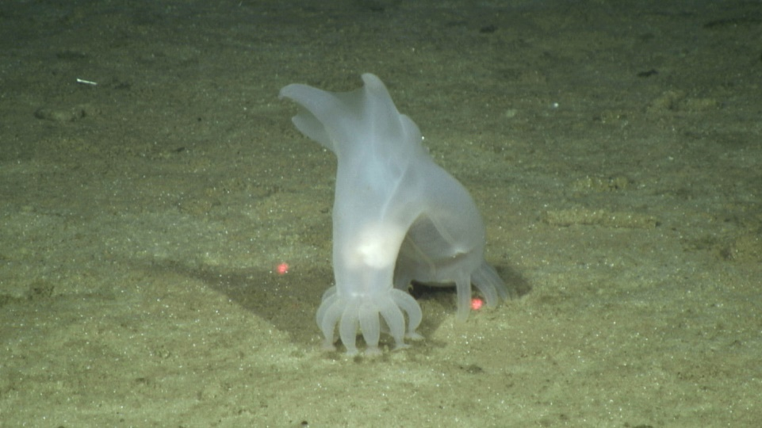
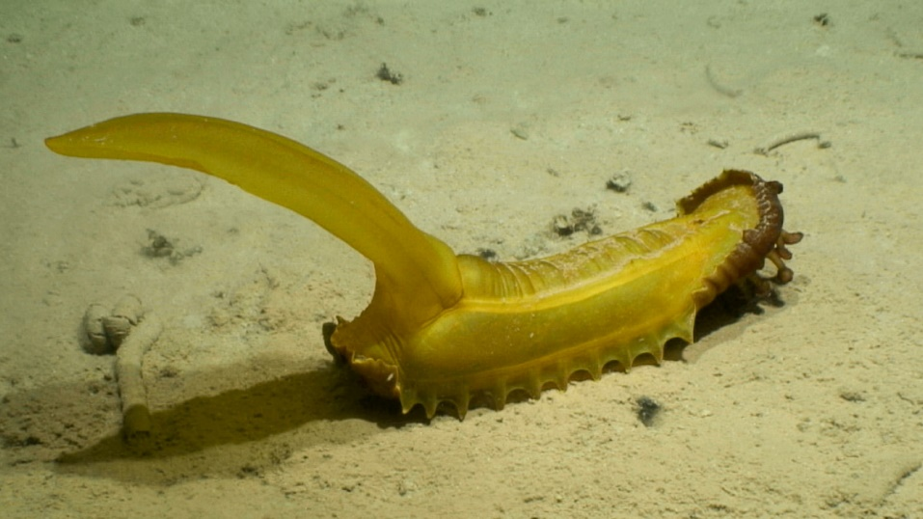
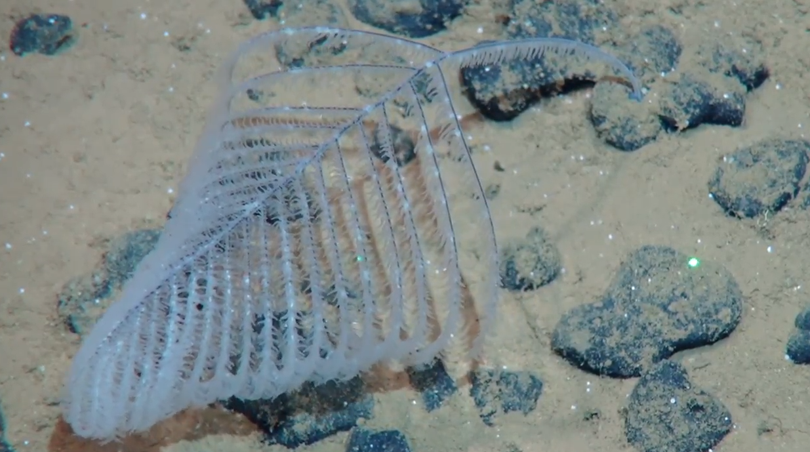
Deep-Sea Ecosystems
Anemones
Sea Cucumbers
Gummy Squirrel
Corals
Sponges
Black Coral
Glass Sponge
Notes:
The environment of the abyssal plain is particularly unique. While the deep sea floor—which comprises about 70% of the world’s sea floor —has been stereotyped as desert-like, it can host significant biodiversity. Some sea life exists in the sea floor sediment (including protozoans, bacteria, and some invertebrate species).

Slide 61
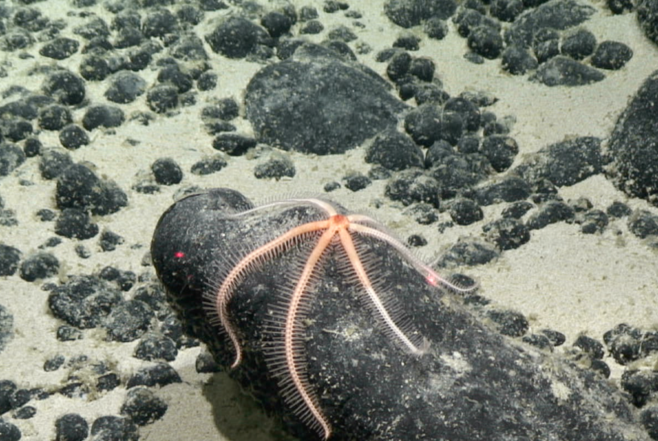
Deep-Sea Ecosystems...On Nodules!
Brisingid Sea Star
Ping Pong Tree Sponge
Deep Sea Worm
Cusk Eel
Notes:
Polymetallic nodules, for example, provide a habitat for deep sea organisms on the abyssal plain such as stalked sponges, soft corals, sea anemones, and barnacles which do not occur on the soft seabed or at shallower depths. The deep sea Hawaiian Casper octopus has been observed laying eggs on sponge stocks growing off of polymetallic nodules. Research of these sea floor habitats has been limited to date, and these ecosystems are still poorly understood. Nevertheless, their delicacy is generally acknowledged: because sediment accumulates on the abyssal plain at a rate of about 1 millimeter per millennium, and polymetallic nodules and cobalt-rich crusts form over the course of millions of years, any disturbance of the ocean floor could be impossible to undo.

Slide 62
Deep-Sea Ecosystems
Crustaceans on an SMS
Wildlife on a Seamount
Notes:
Hydrothermal vent systems are also home to extensive and unique undersea habitats, characterized by the presence of chemosynthetic bacteria, mollusks, worms, and crustaceans. The proximity of SMS to these vent systems will require detailed study and planning in connection with seabed mining, which could irreparably harm the biodiversity of these ecosystems. Cobalt-rich crusts also correspond to unique wildlife habitats because of the seamounts on which the crusts form.

Slide 63
Effects of Sea Floor Disturbance
Notes:
b. Potential Effects of Sea Floor Disturbance
The European Environment Agency and European Commission noted that several activities already physically disturb the seabed habitat, albeit in shallower waters, such as demersal fishing, shipping in shallow waters, finfish aquaculture, port anchorage, dredging, and offshore installations. These activities produce suspended sediment and cause abrasion of the seabed, redirection of currents, and abnormal turbulence. Other underwater disturbances include noise from activities at sea, thermal pollution, and artificial light. While our knowledge of the environmental effects of deep sea mining is still limited, research to date does offer some initial insights.
First, when retrieving polymetallic nodules from the sea floor, deep sea collector machines vacuum up roughly the top four inches of seabed, a process that both removes the surface of the seafloor and creates a sediment plume. Because seafloor sediment accumulates so slowly in the deep sea, attempted restoration of seafloor damage will necessarily be imperfect. However, initial studies of sediment plumes created by deep sea collectors indicate that plumes from deep sea mining may rise only a short distance above the sea floor, possibly due to the relatively low speed of deep sea currents, and therefore may have a less significant impact on sea floor adjacent to mining activities. Nevertheless, these plumes could adversely affect delicate seafloor wildlife.

Slide 64
Terrestrial Mining vs. Seabed Mining
VS.

Slide 65
Resolving the Dilemma
The Precautionary Principle
More Responsible Mining
Recycling

Slide 66
Taking Precautions
In order to protect the environment, the precautionary approach shall be widely applied by States according to their capabilities. Where there are threats of serious or irreversible damage, lack of full scientific certainty shall not be used as a reason for postponing cost-effective measures to prevent environmental degradation.
--Rio Declaration, Principle 15
Notes:
In an effort to balance the potential benefits of seabed mining against its potential (and sometimes unanticipated) environmental costs, policy discussions have centered on—and the ISBA has relied upon—the “precautionary principle.” At a high level, the precautionary principle is a more sophisticated rendering of the adage “better safe than sorry.” The principle has been formulated in many ways, some highly restrictive (e.g., applying to threats of harm, shifting burdens of proof to proponents of an activity) and some more permissive (e.g., considering materiality thresholds and permitting cost-benefit analysis of the proposed action). With respect to seabed mining, the directly applicable formulation of the precautionary principle is Principle 15 of the Rio Declaration, described above. This formulation is incorporated into the ISBA’s exploration regulations and is therefore binding on permit-sponsoring nations and the ISBA

Slide 67
Market Opposition
“Until these matters are sufficiently addressed, we, the undersigned, support a moratorium on deep seabed mining as a matter of precaution and commit not to source minerals from the deep seabed; to exclude such minerals from our supply chains; and not to finance deep seabed mining activities.”

